Slide 1





SPLIT EXPENSES TRACKER
Team Members: Guide:
Narendran G Mrs. R. Umamaheshwari
Akash B
Harshavarth V
Nagarajan M G
Naveen kumar K
:
Disclaimer: The content is curated for educational purposes only.

Slide 2
Split Expenses Tracker
OUTLINE
Abstract
Problem Statement
Aims, Objective & Proposed System/Solution
System Design/Architecture
System Development Approach (Technology Used)
Algorithm & Deployment
Conclusion
Future Scope
Video of the Project
Notes:
These are the list of chapters that we are going to cover in these foundation codes. Those are chapter one what are AI and ML? chapter 2 applied Python programming in AI, and chapter 3 is exploratory data analysis for ML.

Slide 3
Abstract
Split Expenses Tracker
The Split Expenses Tracker is a sophisticated web application engineered to simplify and streamline expense tracking and management for individuals and groups. It harmonizes a robust backend constructed with Node.js and MongoDB for resilient data storage, with a dynamic and user-centric frontend developed using AngularJS.

Slide 4
Problem Statement
Split Expenses Tracker
In various scenarios such as group trips, family outings, small company resource management, and everyday shopping among friends, individuals frequently encounter challenges in effectively tracking, managing, and settling shared expenses. These situations often involve multiple individuals purchasing items, services, or resources, leading to complexities in expense distribution and payment settlement. Challenges Faced: 1. Expense Aggregation: During trips or group activities, multiple purchases are made by different individuals for products, services, travel, and meals, leading to a diverse range of expenses that need to be consolidated and managed efficiently. 2. Unequal Payment Distribution: In situations where one person covers expenses for the entire group or family, difficulties arise in accurately determining the amounts owed by each participant. Equally dividing expenses or accounting for individual contributions becomes a cumbersome task.
3. Difficulty in Tracking: Individuals often struggle to keep track of who owes money to whom, the specific amounts owed, and how much has been reimbursed, leading to confusion and potential discrepancies in settling expenses.

Slide 5
Aim and Objective
Split Expenses Tracker
Aim:
It aims to address the challenges faced in managing shared expenses during group activities, family outings, and small-scale resource management scenarios.
User-friendly interface accessible to individuals participating in shared expenses scenarios, ensuring ease of input, tracking, and settlement.
Enable transparent and equitable distribution of expenses among participants, ensuring accuracy and fairness in calculating owed amounts and settlements.

Slide 6
Aim and Objective
Split Expenses Tracker
Objective:
Design and develop a web-based platform leveraging nodejs and mongodb to establish a robust backend infrastructure for efficient expense management.
Create a responsive and intuitive user interface using HTML, CSS, and JavaScript to facilitate easy expense input, tracking, and visualization for participants.
Implement functionalities to record and categorize expenses, capturing details such as payee, amount, date, and purpose of expenditure for accurate tracking.
Develop algorithms to calculate individual owed amounts based on contributed expenses and enable clear visualization of owed balances for settlements.

Slide 7
Proposed Solution
Split Expenses Tracker
Expense Management Interface : To facilitate efficient input, tracking, and settlement of shared expenses incurred by multiple participants.
Comprehensive Expense Recording : Capabilities to record and categorize expenses comprehensively, capturing details such as payee, amount, date, and purpose of expenditure, ensuring accurate and transparent tracking.
Expense Distribution and Settlement : Algorithms for calculating individual owed amounts based on contributed expenses, offering clear visualization of owed balances for equitable settlements among participants.
Payment Gateway Integration : Seamless integration of diverse payment gateways, including UPI and credit/debit card transactions, to enable secure and convenient payment processing within the system

Slide 8
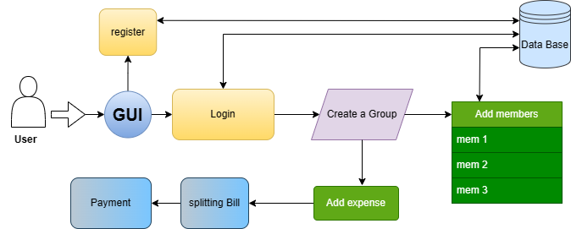
System Architecture
Split Expenses Tracker

Slide 9
System Deployment Approach
Split Expenses Tracker
Frontend Technologies : HTML, CSS, JS
Development Environment : VS code
Backend Technologies : Node JS and MongoDB

Slide 10
Algorithm & Deployment
Split Expenses Tracker
User can register or login to the web page.
User can create the Group for expense splitting.
Add the group member by the user.
Add the expenses by the user, who spend the money and how much they will spend.
Lastly the expenses is divide, and send the message how much money each one is send to their group members.

Slide 11
Conclusion
Split Expenses Tracker
This expense splitting software, expertly crafted with HTML, CSS, JS, NodeJS with MongoDB, delivers a user-friendly and comprehensive solution for managing shared finances.
Looking forward, this software showcases the potential for technological innovation to transform how we manage shared expenses, fostering accountability, transparency, and financial well-being within our friends groups.
Overall, the project demonstrates strong web development and software architecture skills, effectively addressing a real-world challenge with a practical solution. It stands as a valuable tool for streamlining shared expense management.

Slide 12
Future Scope
Split Expenses Tracker
Analyze spending patterns and group behaviour within the app to generate valuable insights for businesses and economic studies.
Enable group goals and savings plans, splitting contributions over time to achieve shared goals.
Debt management: Track and settle debts between friends within the app, avoiding awkward reminders.
AI-powered expense categorization: Automatically categorize expenses based on receipts, transactions, and location, saving time and improving budgeting accuracy.

Slide 13
Split Expenses Tracker
Thank you!
Notes:
thank you very much for joining this PPT, keep learning.
13

